Slide 1
Differential Equations
Marlon Toro

Slide 2
What are differential equations?
How are they used?

Slide 3
Differential Equations
Functions: physical properties
Derivative: their rate of change
Used in: Engineering, Biology, Physics and Economics
Mostly done on computers due to complexities and depth.
Used to model biological processes, celestial motion, and even bridge design.
An equation that relates one or more unknown functions and their derivatives

Slide 4
What is a neural network and how does it work and learn?

Slide 5
Convoluted Neural Networks or CNN
Functions: analyze visual imagery
Shared-weighted architecture using feature maps
Fully connected neurons
Inspired by neurons in animal brains
Optimizes filters through automated learning
An artificial neural network

Slide 6
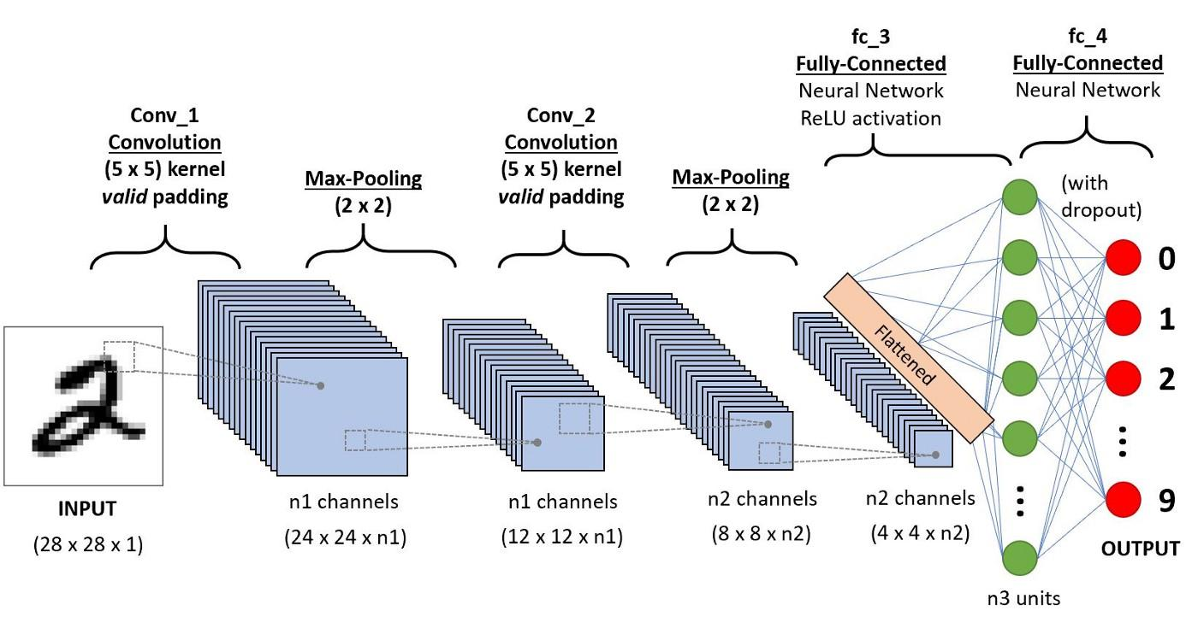
Convoluted Neural Network (CNN) example

Slide 7
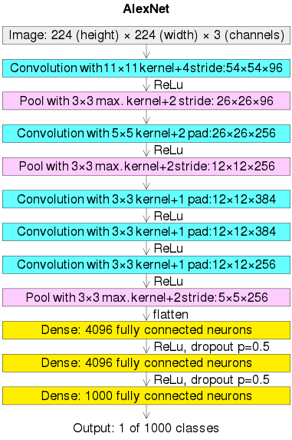
“Alexnet” neural network
Uses convolutional neural network architecture
Created by Alex Krizhevsky and in collaboration with Ilya Sutskever and Geoffrey Hinton.
First image net to win an image recognition contest with top-5 error of 15.3 percent.
Open source and free to use and edit.
Uses convolution, relu and dense function.

Slide 8
CNN (convoluted neural network) Project
Purpose: to construct an A.I. that will differentiate between pictures of a pickup truck and that of a regular car.
Used “Alexnet” architecture and code structure.
Intended possible use in transportation or traffic monitoring and analyses in private companies or governments.
Coded with python and run on Google Colab notebooks.
Pre-loaded with 50 images of cars and 50 images of trucks for training and testing
Was successful at about 80 percent rate and can test any image of a vehicle it has not seen.

Slide 9
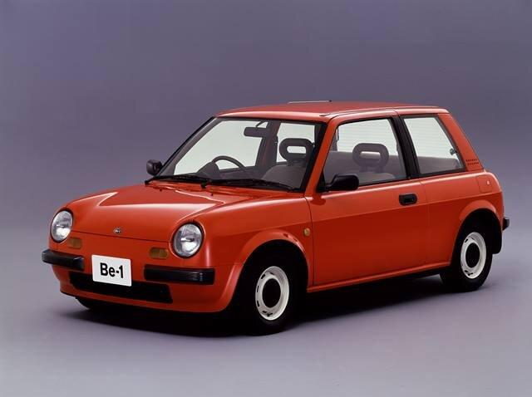
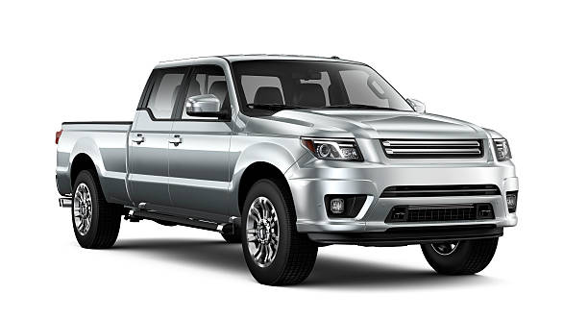
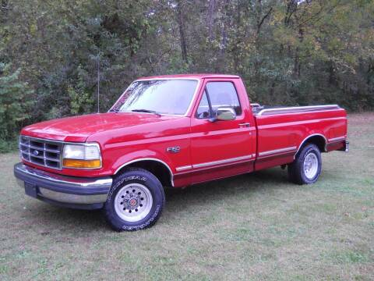
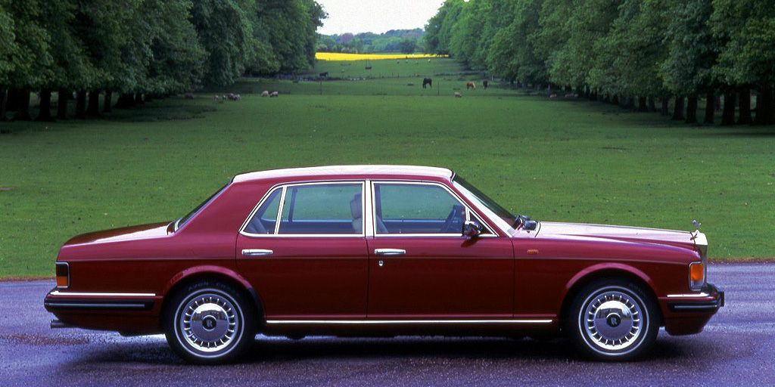
Neural networks in action
Process
Test Images
Decision
Convolution
Maxpool
Repeat steps 1 & 2 as desired
Dense function
Car or Pickup-truck?

Slide 10
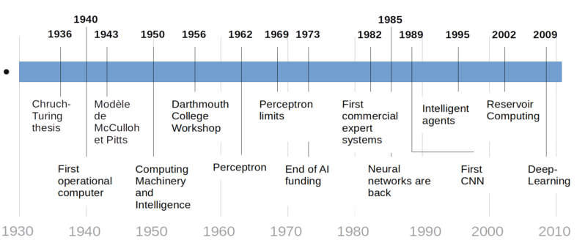
Where will A.I. be used extensively in the future?

Slide 11
Conclusion
Learning about differential equations and their applications into the artificial intelligence world has been a wonderful experience and an eye-opening one. I now understand we are on the precipice of A.I. taking over almost every industry and expanding into every aspect of our lives. I look forward to bring with me all that I have learned and to apply it to my future career and life and to take full advantage of the possibilities A.I. has to offer.

